Slide 1

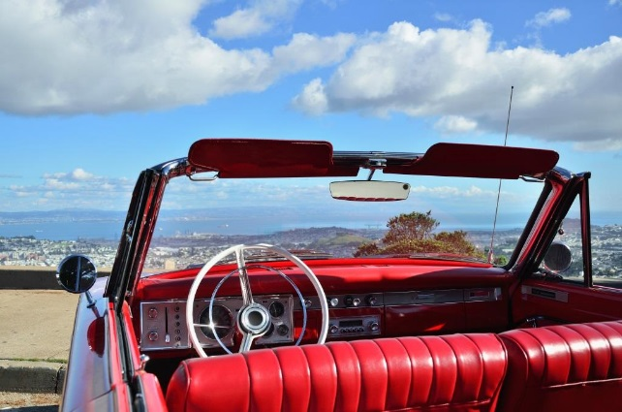
Penn Liberty Motors
Customization

Slide 2
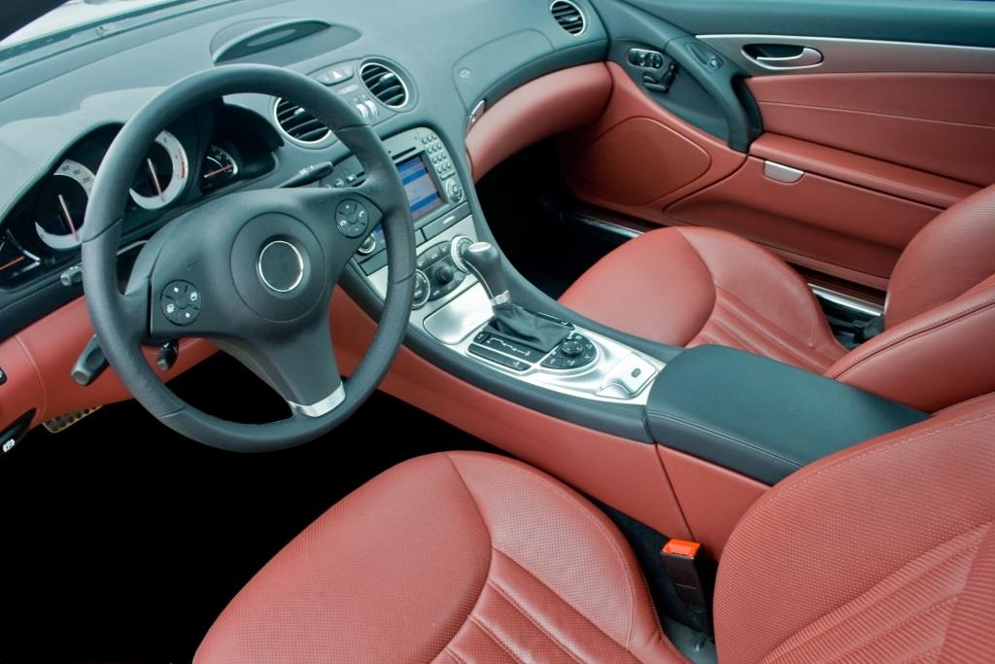
Upholstery Material
Fabric
Vinyl
Leatherette
Leather

Slide 3
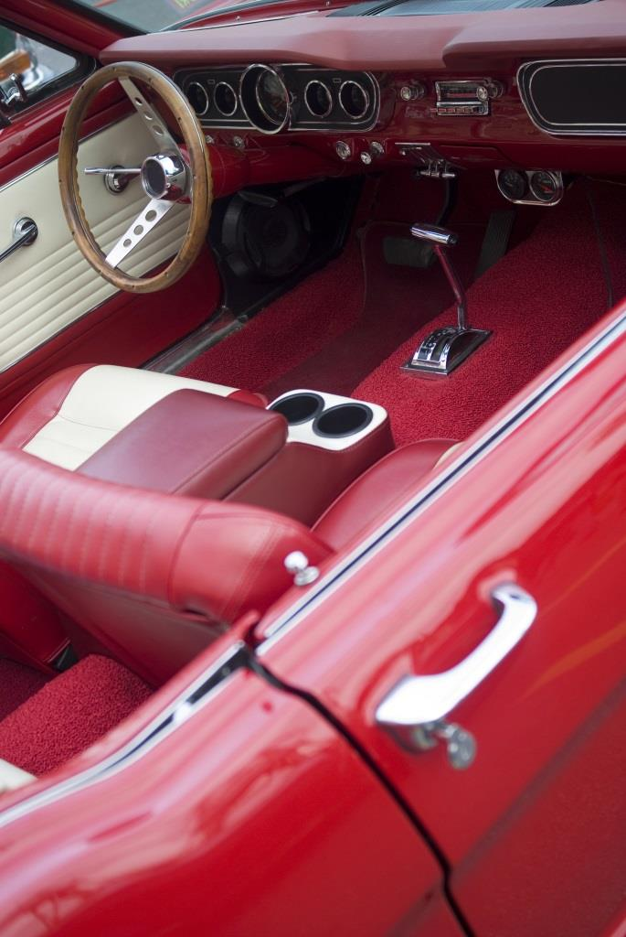
Interior Custom Touches
Twin colored
Piping
Single or doubled stitched

Slide 4
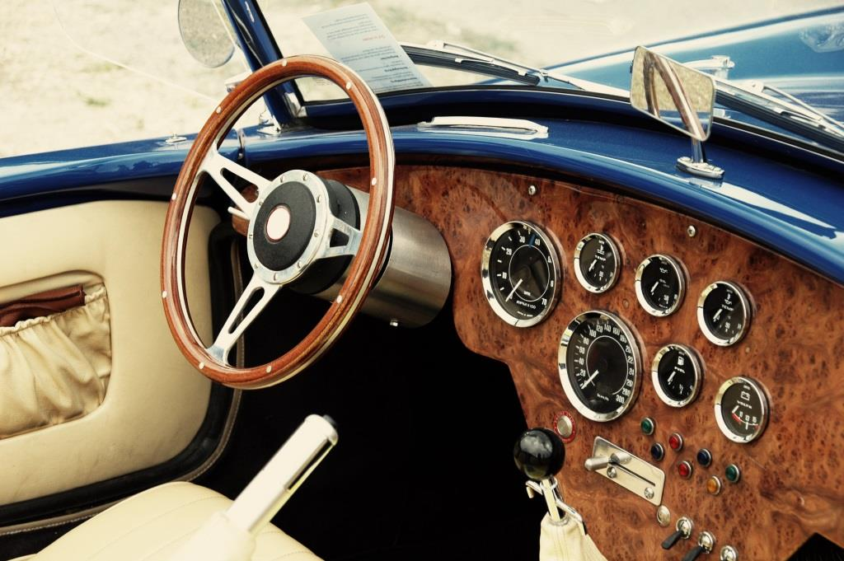
Dashboard
Handmade wood dash panels
Audio and video installation

Slide 5
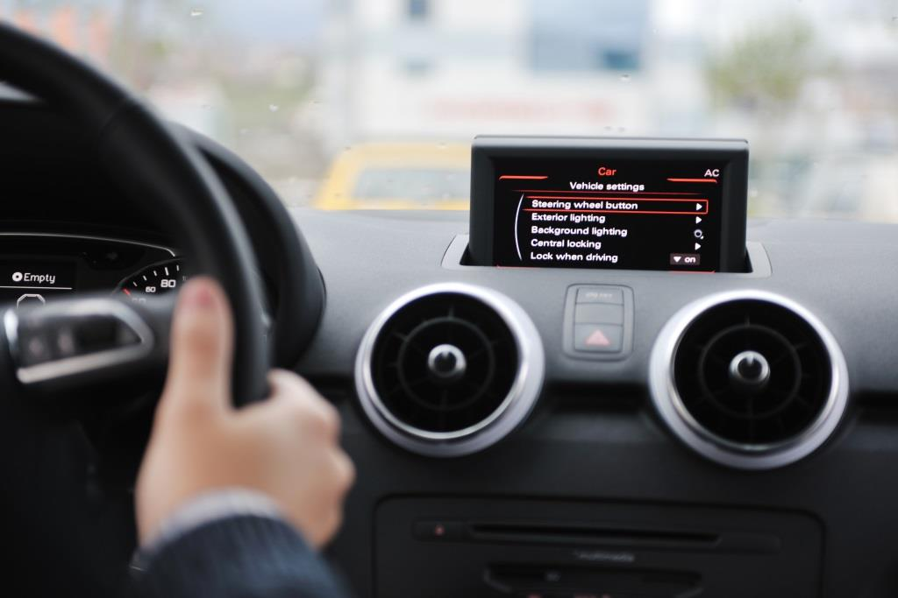
Audio and Video
Custom speakers
Hands free devices
Stereo systems
CD players
DVD players

Slide 6
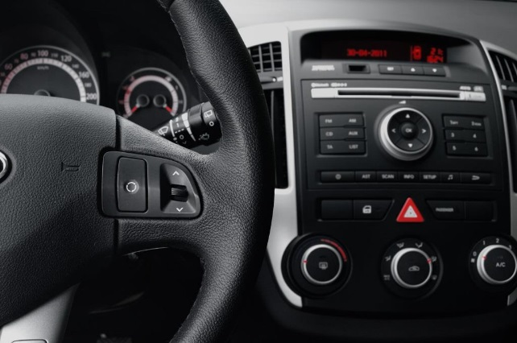
Miscellaneous
Carpeting
Handmade console for CDs
Door inlays
Window tinting

Slide 7
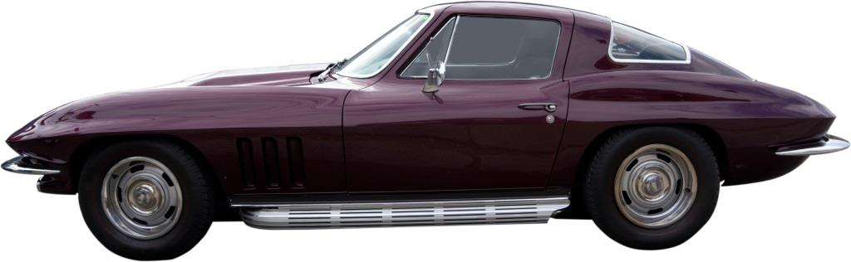
Custom Body Work
Spoilers
Custom paint
Convertible tops
Canvas
Vinyl
Chrome-accented undercarriage

Slide 8

Body Accessories
Custom wheels
Bike and ski racks
Car covers
Chrome accessories
Pin striping
Contact Us

